Slide 1
Seeing is Believing Julia S.Higgins Imperial College, London In the 19th and 20th centuries physicists discovered X-rays, electrons and finally neutrons and how to exploit these as tools to investigate materials behaviour with molecular and sub-molecular level resolution
Neutron Scattering Summer School
September 2022

Slide 2

Connect with

Slide 3
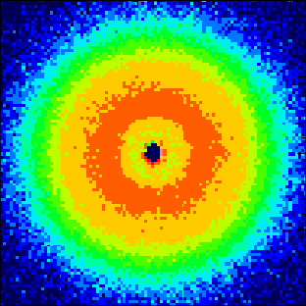
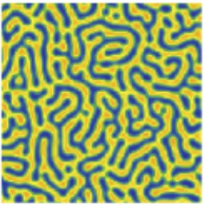
Understanding Morphology using
Small Angle Scattering
Detector
Sample
q
I(q)
Source of radiation
d
0
q
1
d

Slide 4
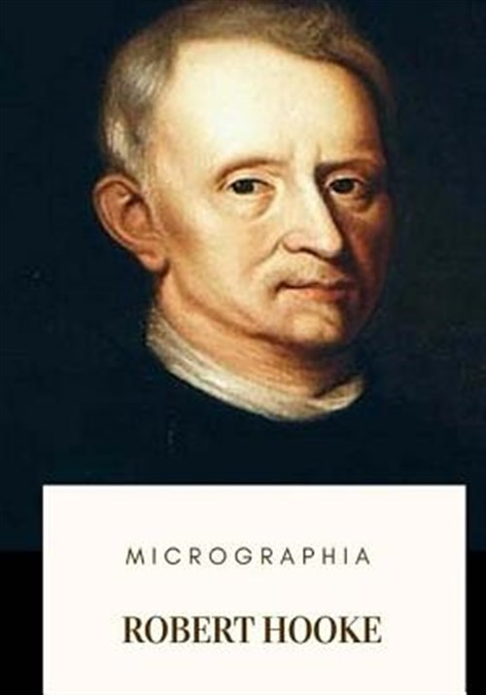
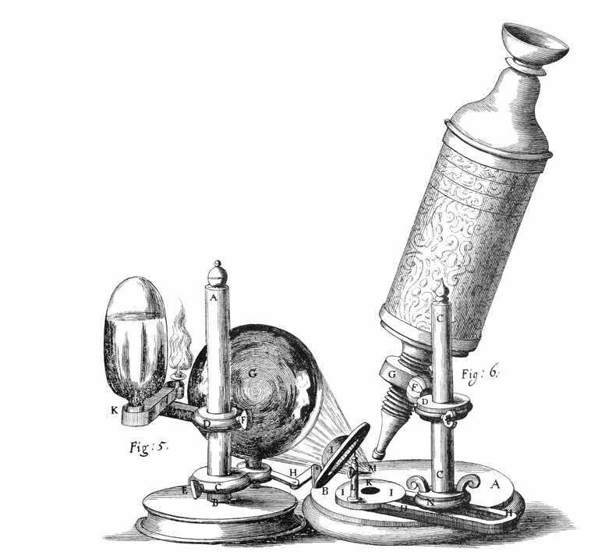
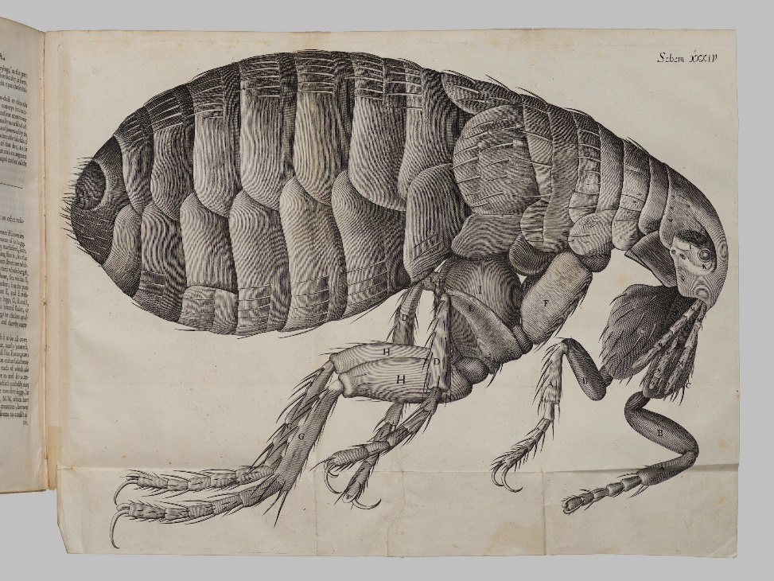
Robert Hooke 1635 to 1703 Curator of Experiments at the Royal Society

Slide 5
Early experimental observation used light microscopy
So how do we see with light?
Consider a simple experiment
Change the surroundings of an object

Slide 6
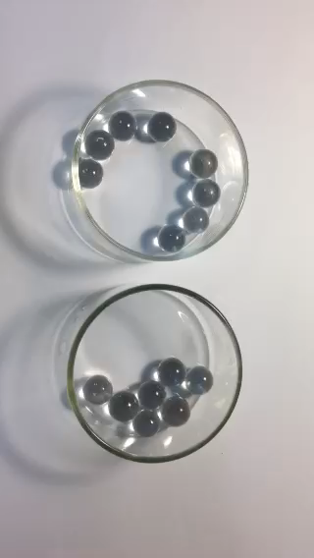
MOVIE

Slide 7
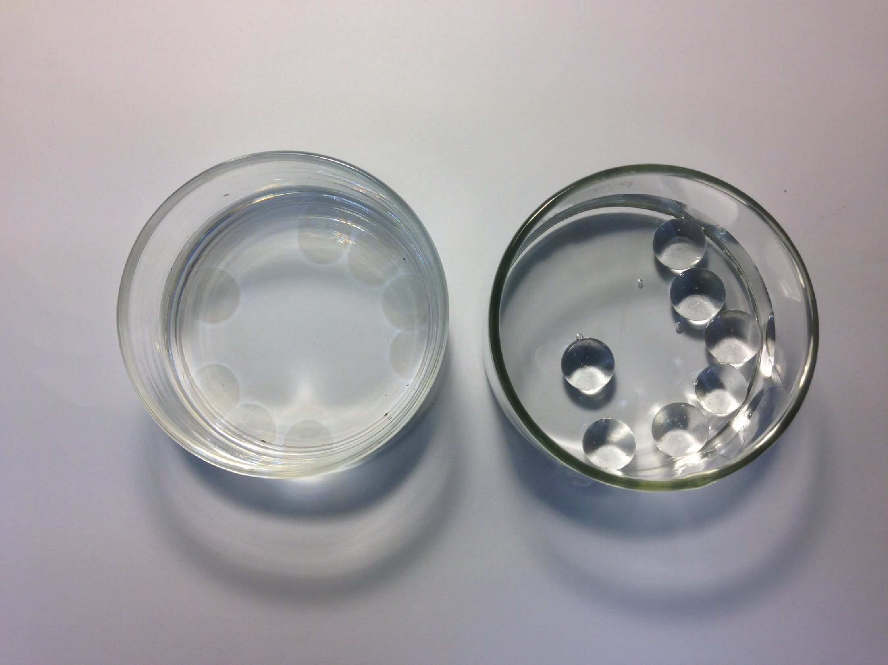

Slide 8
Contrast
Contrast (different interaction of radiation with sample)
Seeing objects requires a difference in refractive index between the object and its surroundings
contrast
no contrast
n (air) ~ 1
n (water) ~ 1.33
n (glass) ~ 1.50
n (toluene) ~ 1.49
Glass beads:
nearly disappear in toluene
best visible in air.
Any radiation can be used in the same way as light to “see”. The requirement is a difference between the way the radiation interacts with the atoms and molecules in the object and its surroundings, i.e. CONTRAST.

Slide 9
What is light?
Newton et al corpuscles
Thomas Young et al waves
Experiments BOTH!

Slide 10
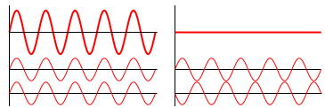
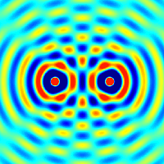
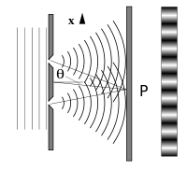

Interference of waves
constructive
destructive

Slide 11
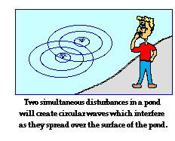
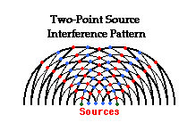
Interfering waves on water

Slide 12

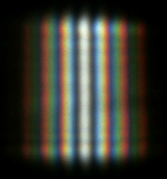
The double slit experiment interference of light waves
Thomas Young
1773-1829
Disagreed with Newton’s corpuscular theory of light

Slide 13
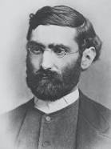
Limitations of light microscopy resolution In the 1870s, Ernst Abbe explained why the resolution of a microscope is limited and cannot produce images of an object that is smaller than half the wavelength of the light wave-typically 200nm. Molecules are in the size range 0.1 to 10nm so molecular structures are never visible under light microscopy

Slide 14
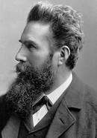
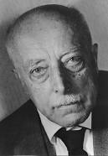
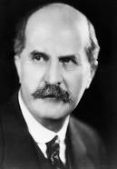
Discovery and Exploitation of of X-rays X-rays are part of light spectrum with wavelength 1/1000
Max von Laue showed X-rays scattered from crystals interfere in diffraction patterns so they are waves. Nobel 1914
William Henry Bragg worked on X-rays in Leeds 1909 to 1915
1895 Wilhelm Roentgen discovered X-rays and showed first X-ray photographs .

Slide 15
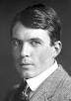
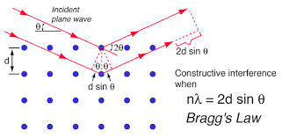
X-ray diffraction and the Bragg Equation
William Henry and William Lawrence, father and son win Nobel prize 1915 for X-ray diffraction
λ is the X-ray wavelength and θ the angle of diffraction

Slide 16
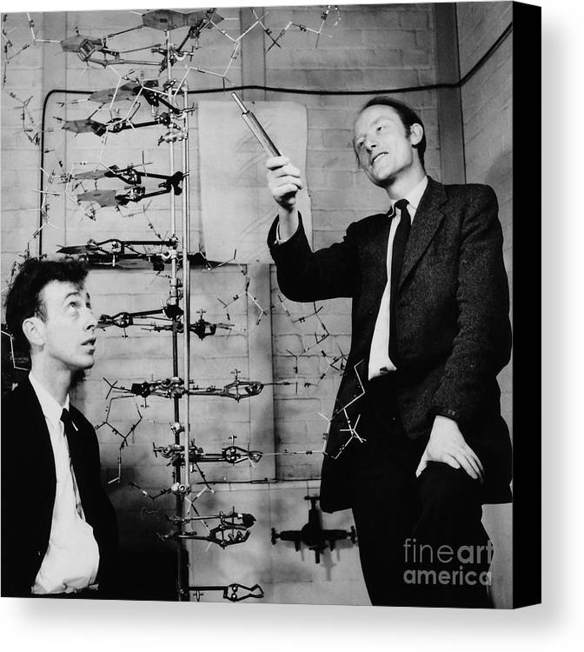
The structure of DNA - Watson and Crick 1953
X-ray crystallography has elucidated many molecular structures - a famous high point being the double helix

Slide 17
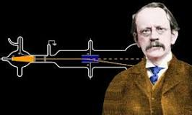
Discovery of electrons and electron diffraction
Cathode rays discovered when an electric charge passed through a vacuum tube first observed in 1869
In 1897 J.J.Thomson working on cathode rays showed they were deflected by magnets and therefore were electric charge bearing particles
In the early 20century physicists were developing understanding of the nature of matter and radiation and the important role of quantum mechanics. Light was already known to have a dual nature - both wave and particle, and then Louis de Broglie arrived on the scene

Slide 18
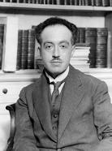
Properties of electrons and electron diffraction
Louis de Broglie 1892-1987
PhD 1924 “all matter has wave properties”
Wavelength λ= h/mv
where h is Planck’s constant
mv = momentum = 2E/v
λ = h/√(2mE)
therefore electron wavelength depends on the accelerating voltage
Ie for V = 100volts λ = 0.05nm
In 1927 electron diffraction was independently observed by C.P.Davisson and L.H.Germeer in New York and G.P.Thomson in Aberdeen, confirming the de Broglie equation

Slide 19
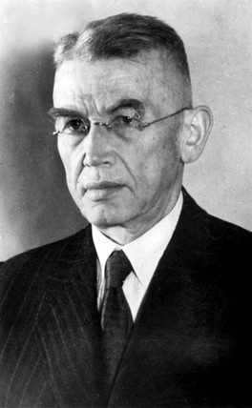
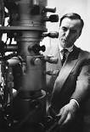
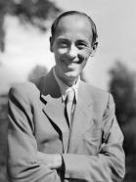
Limitations of resolution with light microscopy lead to the electron microscope 1931
Hans Busch builds first electromagnetic lens in 1926 in Jena
Ernst Ruska and Max Knoll build first em microscope in 1931 in Berlin
And the rest is history!

Slide 20
Tools for studying materials available to scientists in the early 20th century
Light and electron microscopy
X-ray crystallography
But
No tools for studying internal structure of non-crystalline materials
Rubbers, glasses, plastics

Slide 21

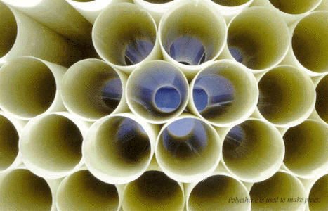
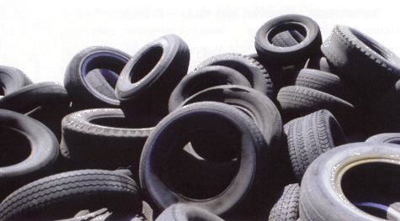
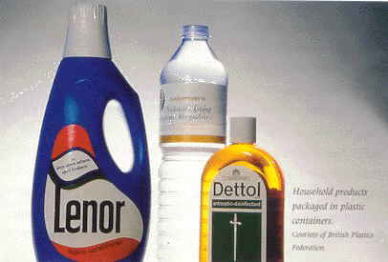
Effect of Mw on flow
What are Polymeric materials?

Slide 22
PE poly(ethylene)
PS poly(styrene)
PMMA poly(methylmethacrylate)
PB poly(butadiene)
CH₃
PVC poly(vinylchloride)
BPA-PC bisphenol-A polycarbonate
O

Slide 23
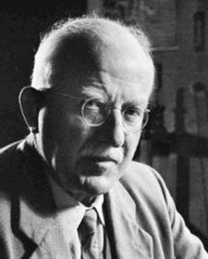
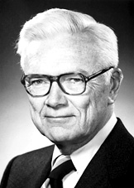
Physics of polymer molecules and polymeric materials
1920 Hermann Staudinger first proposed plastics were composed of very long molecules with co-valent bonds
1953 Paul J Flory described the shape and size of individual polymer molecules in solutions and melts. In the melt molecular dimensions increase as √N, but they are larger in solution because of excluded volume effects

Slide 24
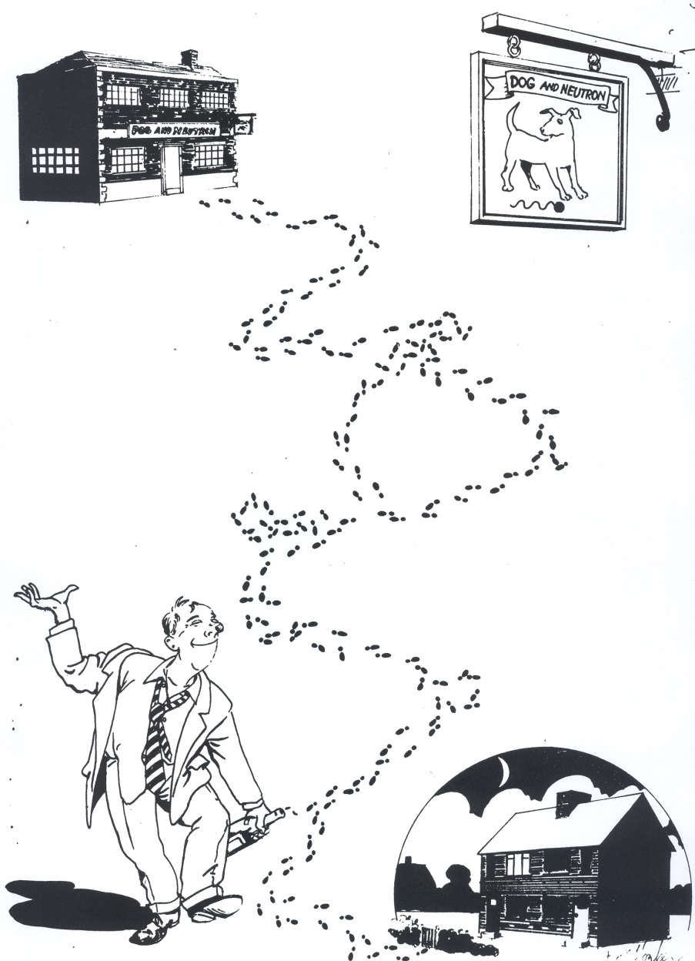
The drunkard’s walk

Slide 25
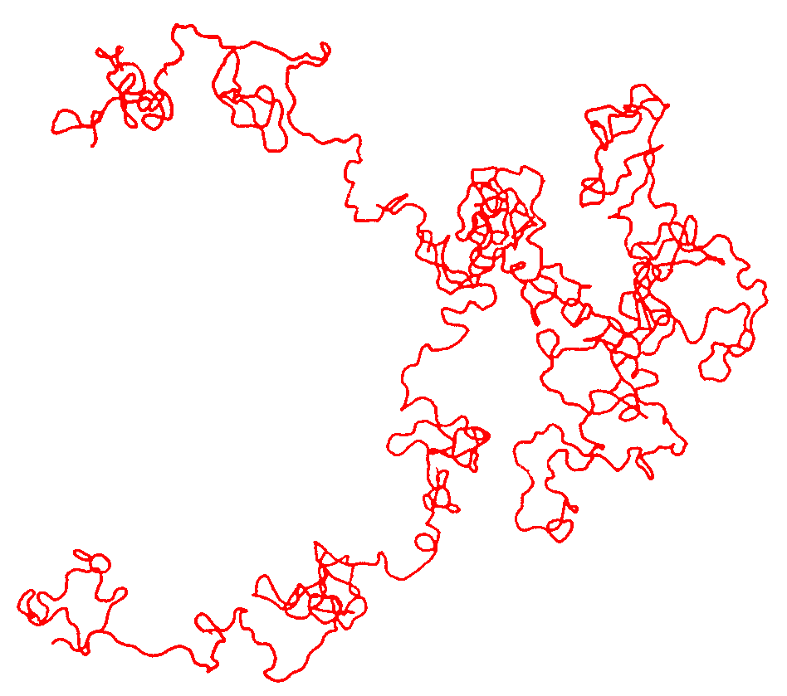
Single polymer molecule in a melt
1000 repeat units long

Slide 26
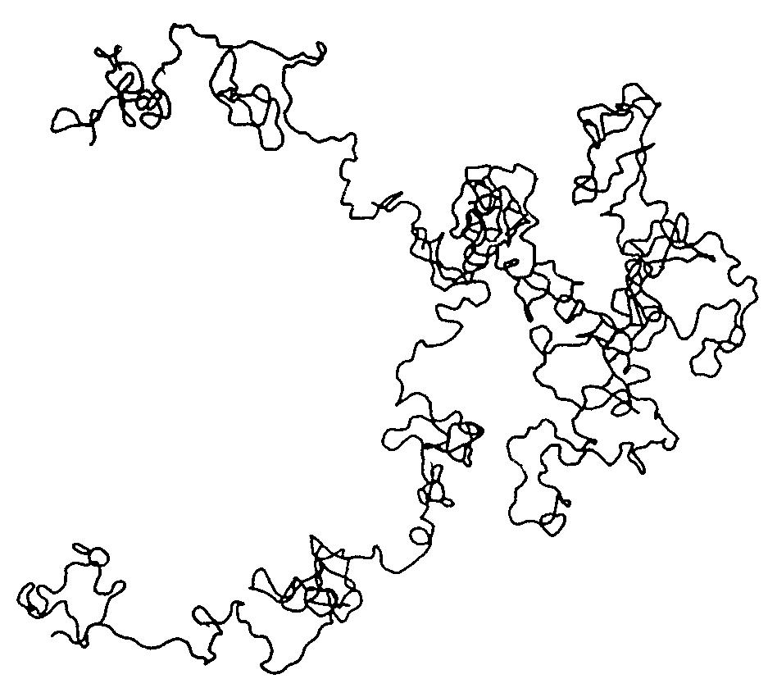
Entangled polymers – many random walks

Slide 27


Effect of deformation on polymer conformation
High Mw samples show stress
relaxation – the force needed
to keep them stretched
reduces with time
Short vs long macromolecules (Mw)

Slide 28
Big questions for polymer scientists still open in 1970
Is the individual polymer molecule a “random walk” in a melt sample (Flory)?
How does the individual polymer molecule relax after it has been stretched in a melt?
Use small angle scattering to look at molecular size and shape

Slide 29
T
This is a “phase diagram” for two partially miscible fluids – in our case two polymers.
t
Temperature is plotted against concentration of the mixture. Above the curves the system separates out – becomes cloudy.
φ’
φ’’
The video will show a microscopic view of what happens when T rises suddenly from the lower dot to the higher dot

Slide 30


Slide 31
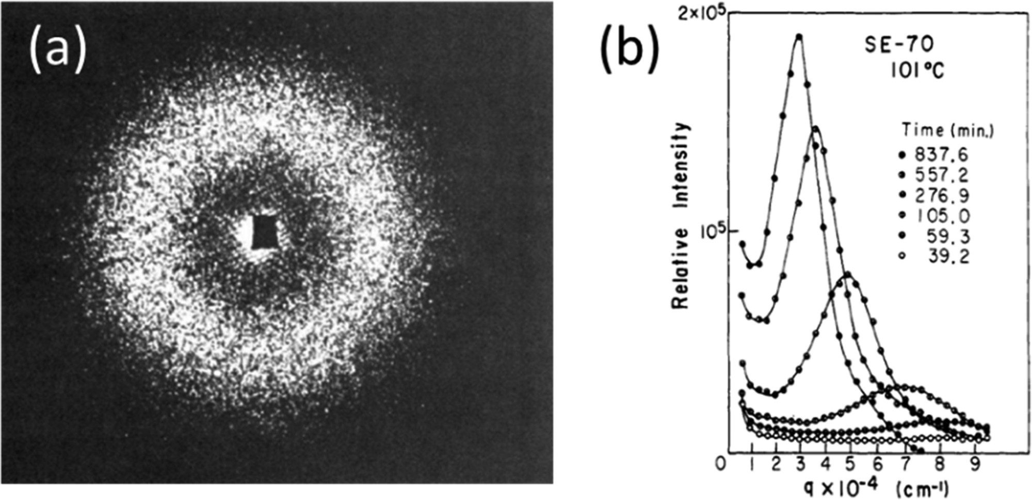

Slide 32
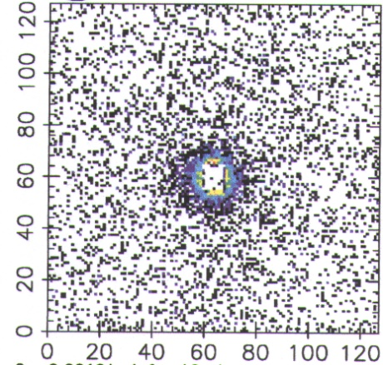
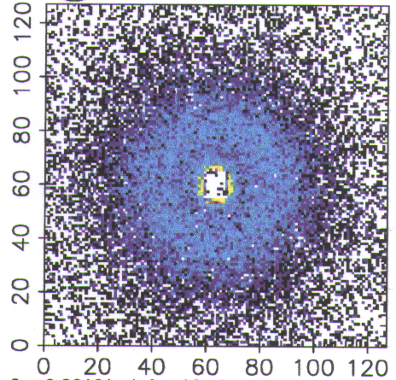
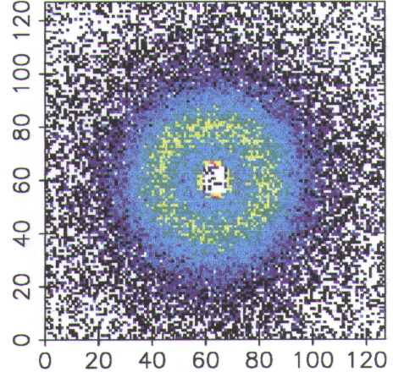
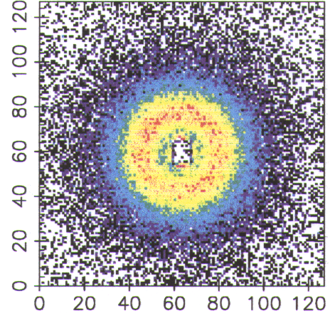
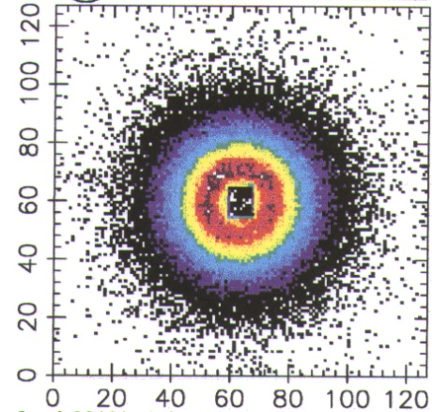
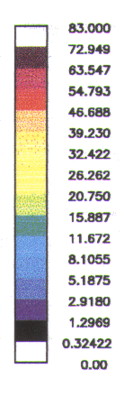
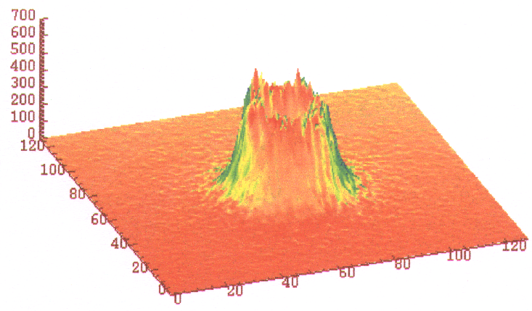
Real time SANS
TMPC/PSd 70/30 T=252ºC
Time
x 30 s
I (au)
q x
q y
10

Slide 33
As the structure gets bigger with time, the scattered ring gets smaller
Large objects scatter at small angles
Small objects scatter at large angles

Slide 34
Contrast
How do we “see” a polymer molecule?
Radiation
Source of contrast
LIGHT?
Refractive index (n) difference, related to electronic structure. Measurement of molecular size of polymer molecules in solution with light scattering
X-rays?
Electron density difference, i.e. heavy atoms are more visible Scientists tried looking at polymer molecules in melts by labelling the ends with heavy atoms
Neither technique allows molecular labelling in a melt without changing the nature of the material.

Slide 35
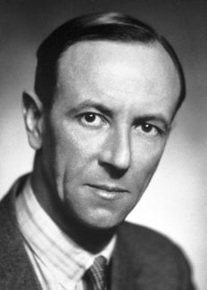
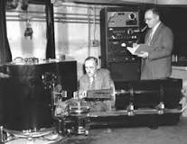
Discovery and Exploitation of the neutron
1932 James Chadwick discovered neutral particles in the atomic nucleus
First nuclear reactor built in Chicago 1942. Materials testing reactor, Dido built at Harwell 1956
First neutron diffraction results from a crystal of NaCl by Wollan and Shull (pictured) in Oakridge 1945

Slide 36
The Neutron
m_{n}
v
Wave-particle duality
h
λ
=
m_{n}v
λ
de Broglie
(1924)
m_{n} = 1.674 x 10⁻²⁷ kg
Thus:
λ
~
10⁻¹⁰ m
E
~
k_{B}T
Neutrons scattered by nucleus
isotopic substitution - labelling
Neutrons highly penetrating & non-destructive
Very Expensive
nuclear reactors or spallation sources

Slide 37
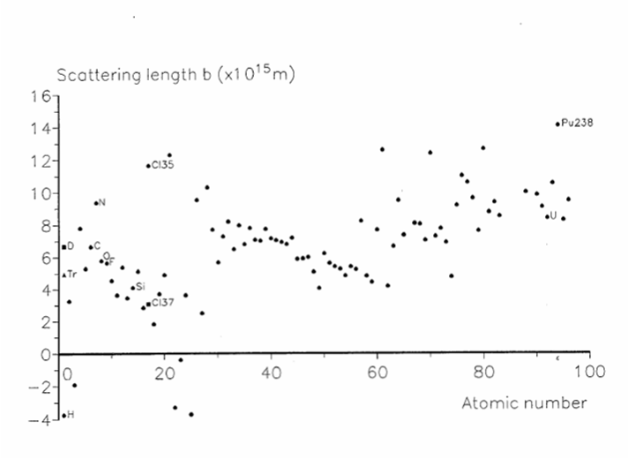



Slide 38
Contrast
How do we “see” things?
Radiation
Source of contrast
LIGHT?
Refractive index (n) difference, related to electronic structure
X-rays?
Electron density difference, i.e. heavy atoms are more visible
Neutrons?
Interaction with the nucleus – isotopic effects and labelling possible especially H-D contrast

Slide 39
Entangled polymers – many random walks
Use deuterium substitution to label the black molecule in a neutron scattering experiment

Slide 40

Neutron scattering
neutron beam
H
D
H
H
H
D
D
D
chemically identical
C
C
C
C
C
C
H
H
H
D
D
D
enormous neutron contrast

Slide 41
PE poly(ethylene)
PS poly(styrene)
PMMA poly(methylmethacrylate)
PB poly(butadiene)
CH₃
PVC poly(vinylchloride)
BPA-PC bisphenol-A polycarbonate
O

Slide 42
Big questions for polymer scientists still open in 1970
Q1 Is the individual polymer molecule a “random walk” in a melt sample (Flory)? Is the size proportional to the square root of the number of units in the chain ie its molecular weight
Q2 How does the individual polymer molecule relax after it has been stretched in a melt? Does the size along the stretch direction relax back to the unstretched size?

Slide 43
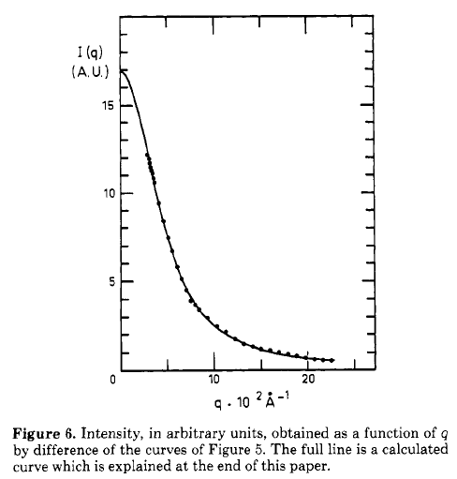

Q1
good solvent
R_{g}
melt (θ)
Slope = 0.5
1/Rg

Slide 44
Effect of deformation on polymer conformation
Q2
Experiment
Make a mixture of D and H polystryrene molecules
Stretch it at T above 100C where polystyrene softens
Hold it stretched for a measured length of time t
Quench it in cold water to freeze in the remaining stretch
Look at it with neutrons and plot remaining molecular stretch against time

Slide 45
Q2
REMEMBER
Large objects scatter at small angles
Small objects scatter at large angles
When the molecules stretch the pattern elongates in the perpendicular direction

Slide 46
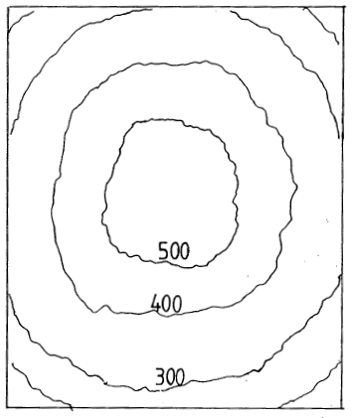
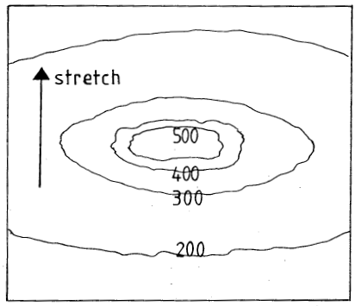
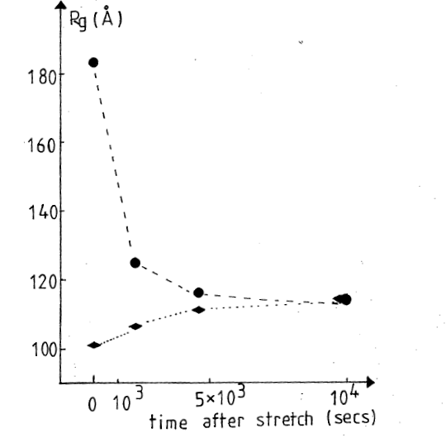
Q2
Scattering pattern gets BIGGER when scattering object gets SMALLER
Size along the stretch
polystyrene-D8 (3%) in polystyrene-H8 (97%) stretched by 200% and then allowed to relax before quenching. We stretched the polymer and waited a measured time before freezing it
90 degrees to stretch

Slide 47



Slide 48
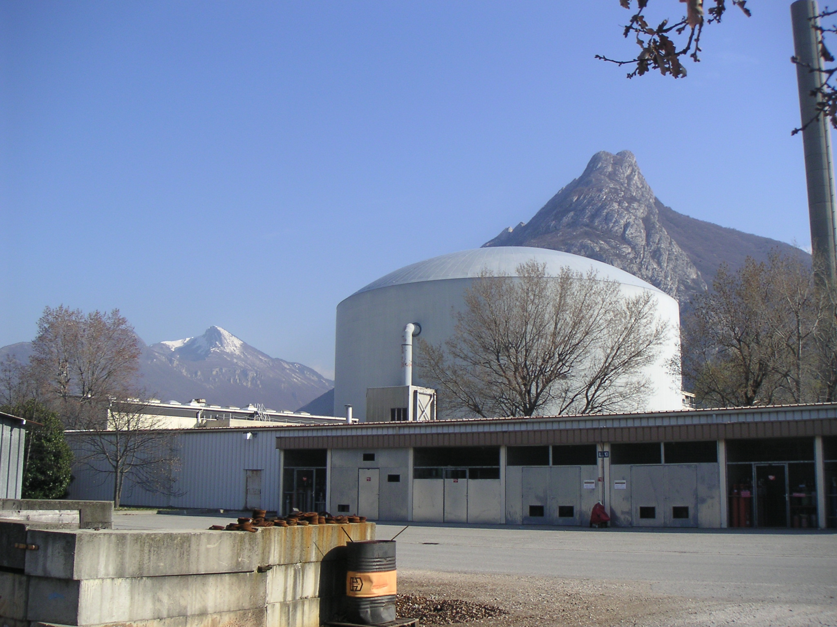
The ILL reactor with the French Alps behind started exeriments1972

Slide 49
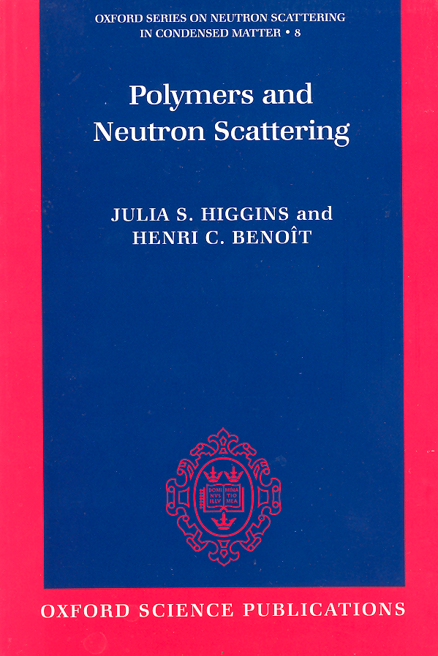
Many other questions about molecular basis for behaviour of polymeric materials answered using neutrons

Slide 50
Neutron scattering techniques showing new insight into behaviour of polymeric materials
Small Angle Scattering
Time resolved SANS
Neutron reflection
Quasi-elastic scattering – time of flight, back scattering, spin-echo

Slide 51
Connect with

